Slide 1
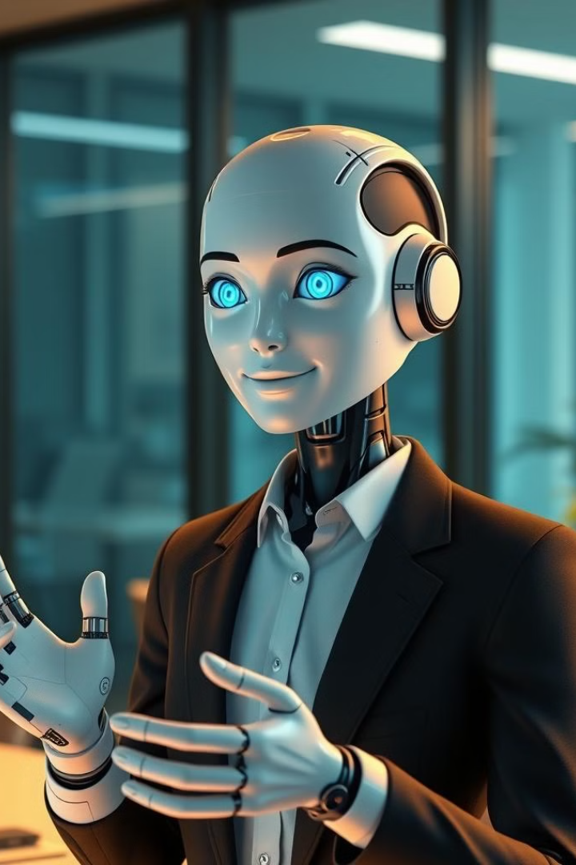
Introducing Avatar Lab: AI-Powered Talking Heads
Avatar Lab is a cutting-edge system that transforms text into realistic talking head videos. Our AI-powered avatars feature natural facial expressions and accurate lip synchronization. This innovative solution integrates state-of-the-art deep learning models for lifelike digital avatars.

Slide 2
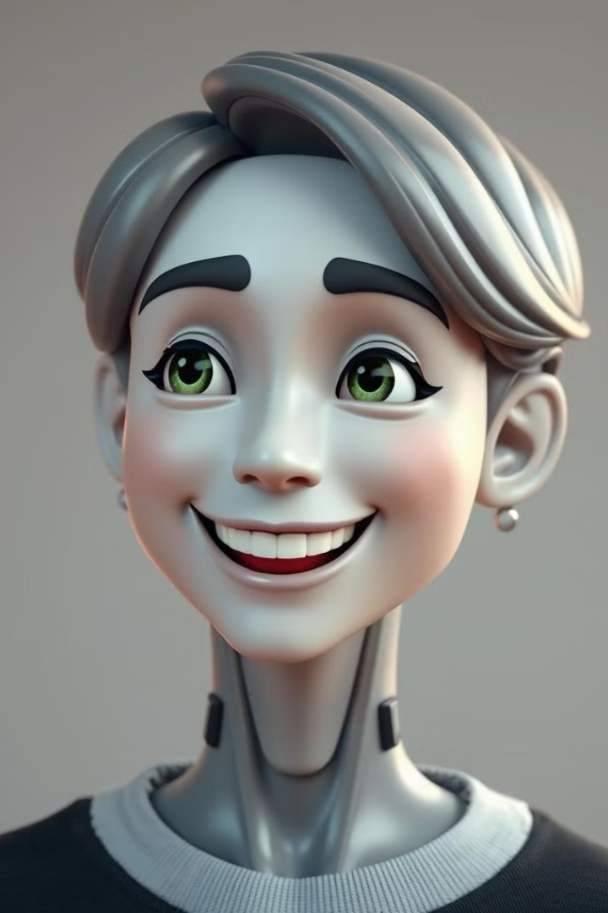

Project Outcome
Avatar Lab will be a fully functional system that converts text input into realistic talking head videos with AI-generated avatars.
Key features include:
Realistic facial expressions matching speech
Accurate lip synchronization with generated speech
Emotion-based animations for expressive avatars
Natural voice modulation using AI-driven text-to-speech

Slide 3

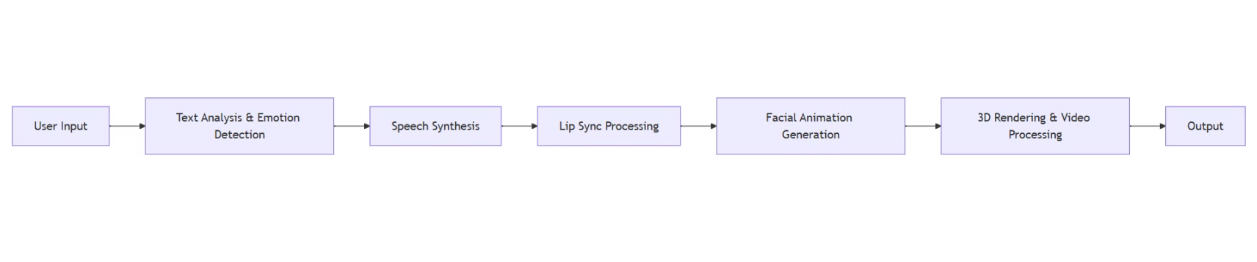
User Interaction and Workflow
User Interaction Flow:
🔹 Input: Users enter text → Choose avatar → Choose voice 🔹 Processing: AI system generates speech, synchronizes lips, and animates the avatar 🔹 Output: A fully animated, lip-synced talking head video

Slide 4



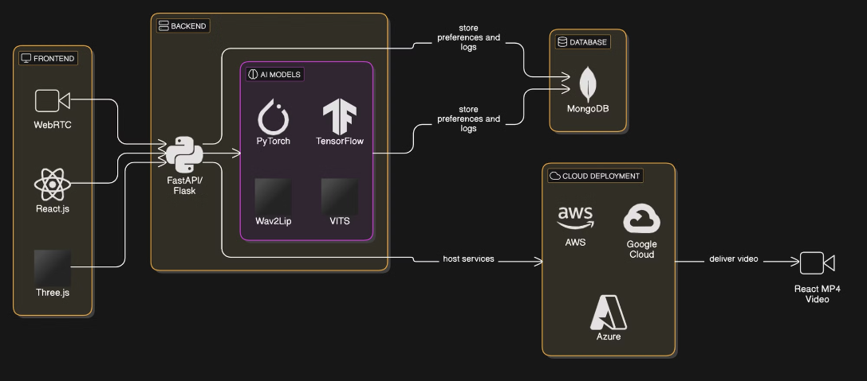
Tech Stack and Architecture
Backend
Frontend
Deployment
Deep Learning Frameworks: PyTorch, TensorFlow
React.js – Interactive UI
Cloud Hosting: AWS / Google Cloud / Azure
Three.js – 3D avatar rendering
Model Serving: FastAPI, Flask
Facial Animation Model: DiffTalk
WebRTC/FFmpeg – Real-time video processing
Text-to-Speech (TTS): VITS
Lip Syncing: Wav2Lip
Database
MySQL/ MongoDB

Slide 5
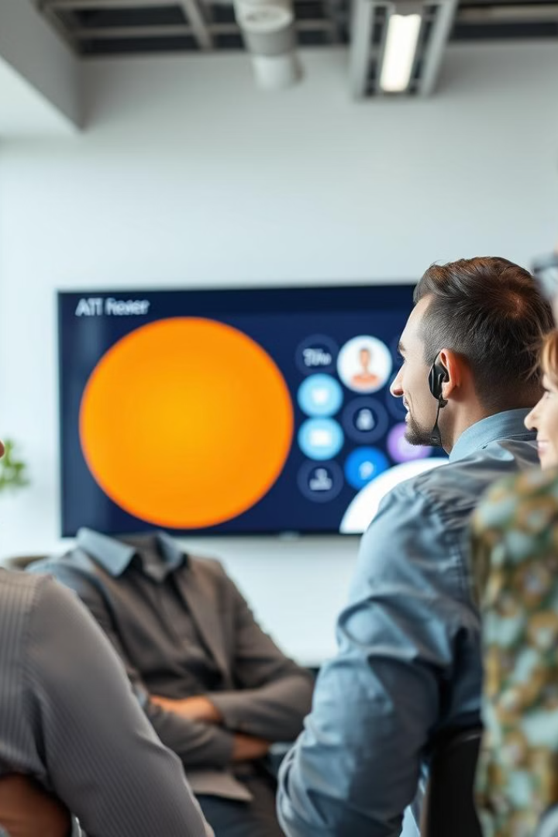
Business Problem
Traditional avatars lack realism, video production is costly, and accessibility is limited. Avatar Lab solves this by using AI for realistic facial animations, automated video generation, and enhanced communication across various domains. 🚀
Typical Users
📺 Newsreaders – Automate news delivery with AI avatars
👩‍🏫 Educators – Create interactive AI tutors
📹 Content Creators – Streamline avatar-based video production
🦻 People with Disabilities – Enhance accessibility with AI-driven avatars
🏥 Healthcare & Therapy – Assist in mental health and patient interactions
💼 Corporate & Customer Support – Develop AI-powered virtual agents

Slide 6

Thank you

